Slide 1
Supervised Learning
Lesson 20.1

Slide 2
Class Objectives
By the end of this lesson, you will be able to:
Model and fit several supervised learning linear models (linear regression, logistic regression) using scikit-learn.
Conceptualize and build training and test windows for supervised learning analysis.
Define classification in the context of machine learning.
Evaluate classification algorithms using a confusion matrix and classification report.

Slide 4
Introduction to Supervised Learning & Classification
Notes:
### 1. Instructor Do: Introduction to Supervised Learning & Classification (15 minutes)

Slide 5




Introduction to Supervised Learning
In supervised learning, we take a set of known answers called labels and fit a model with a set of features (inputs) that corresponds to the labels.
These models are called supervised learners.
Pears
Bananas
Supervised Learning
Fruit
Apples
Oranges
Notes:
shutterstock_1665264154

Slide 6

Supervised learning requires us to feed the correct answers to the model.
Notes:
shutterstock_2000727815

Slide 7


Introduction to Supervised Learning
The model learns from the data and the answers. It becomes better at predicting the correct answer as we provide more data.
Feature vectors
2
1
Input labeled data for learning
1
Machine learning algorithm
1
3
2
Results
After learning, new data can be predicted
Predictive model
3
2

Slide 8

Introduction to Supervised Learning
Supervised learners generally fall into one of two broad categories:
Classification Regression
y
y
x
x

Slide 9
What is regression?

Slide 10
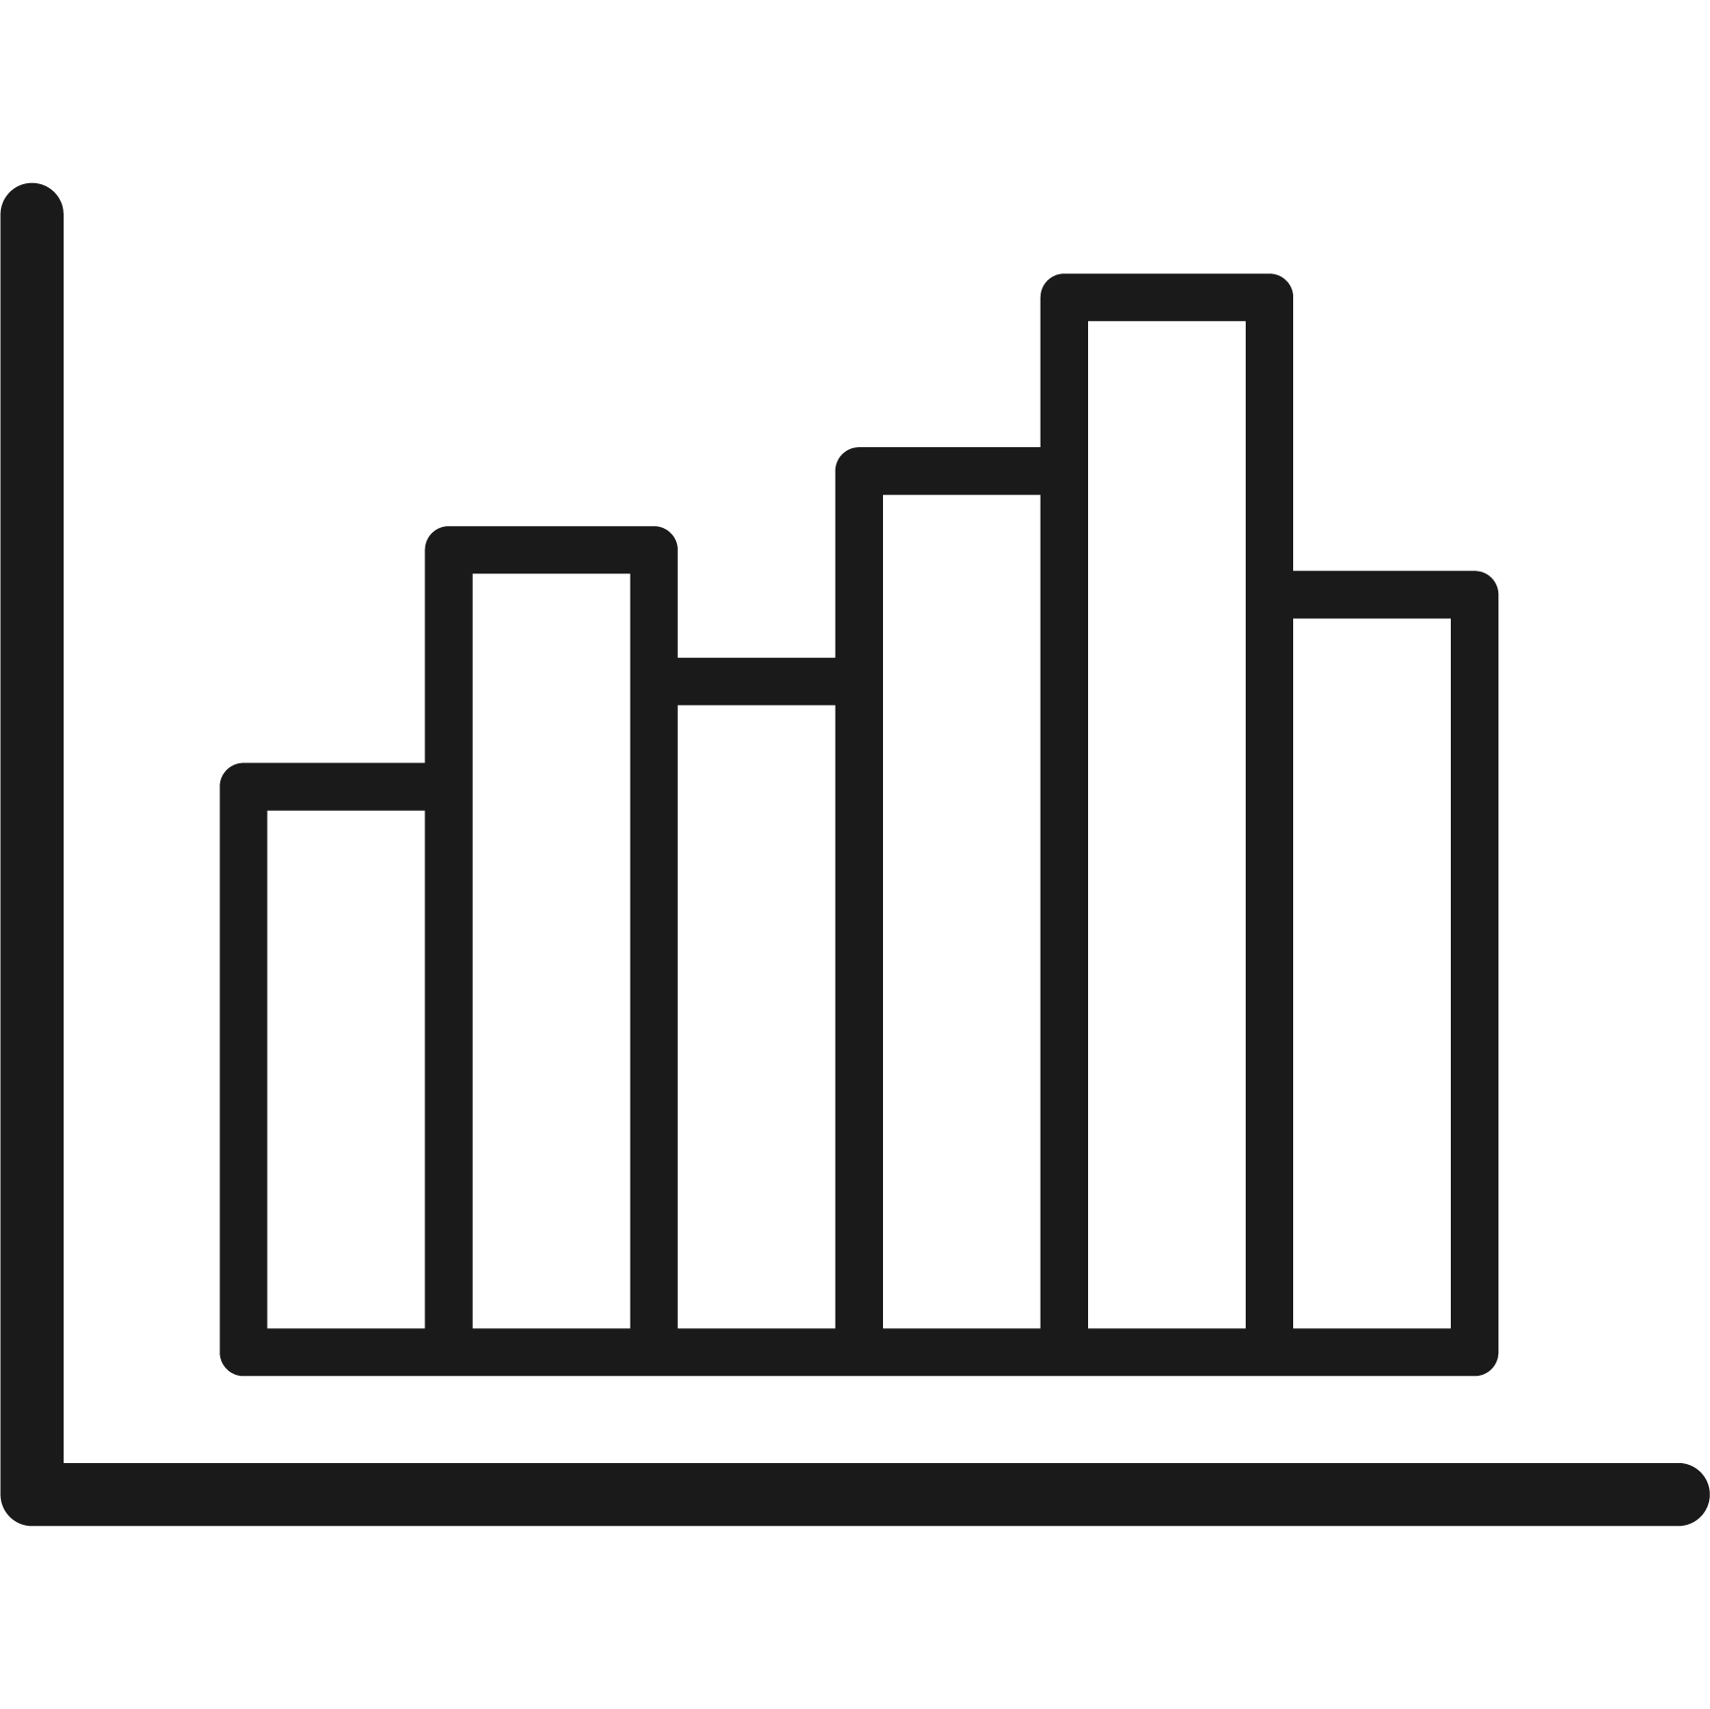
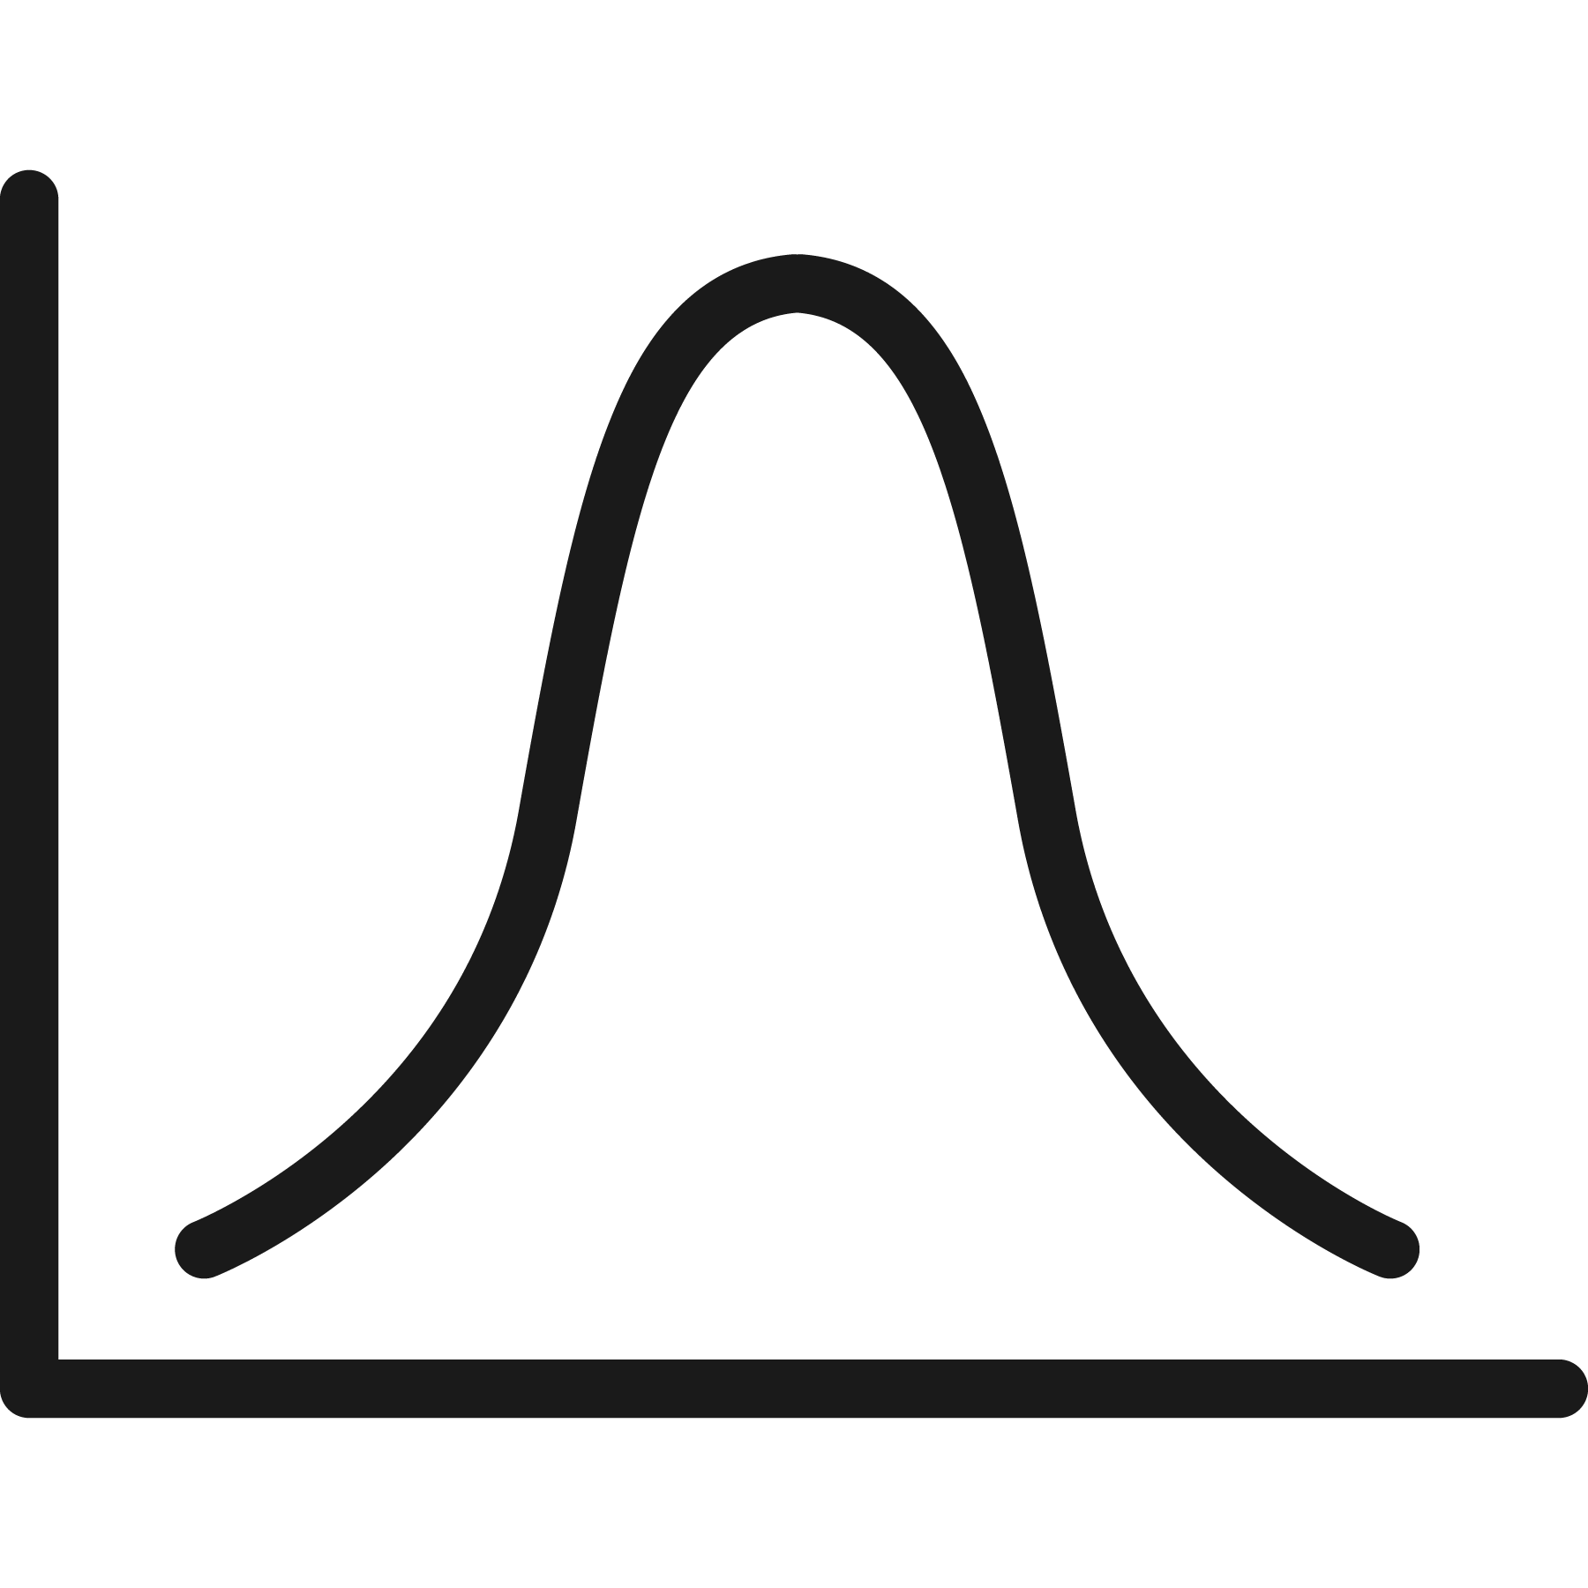
Regression
Regression is a method for predicting continuous valued variables.
Continuous values
Continuous variables
Those that can always be divided into smaller pieces.
No matter how small, these will have a middle that we can find.

Slide 11
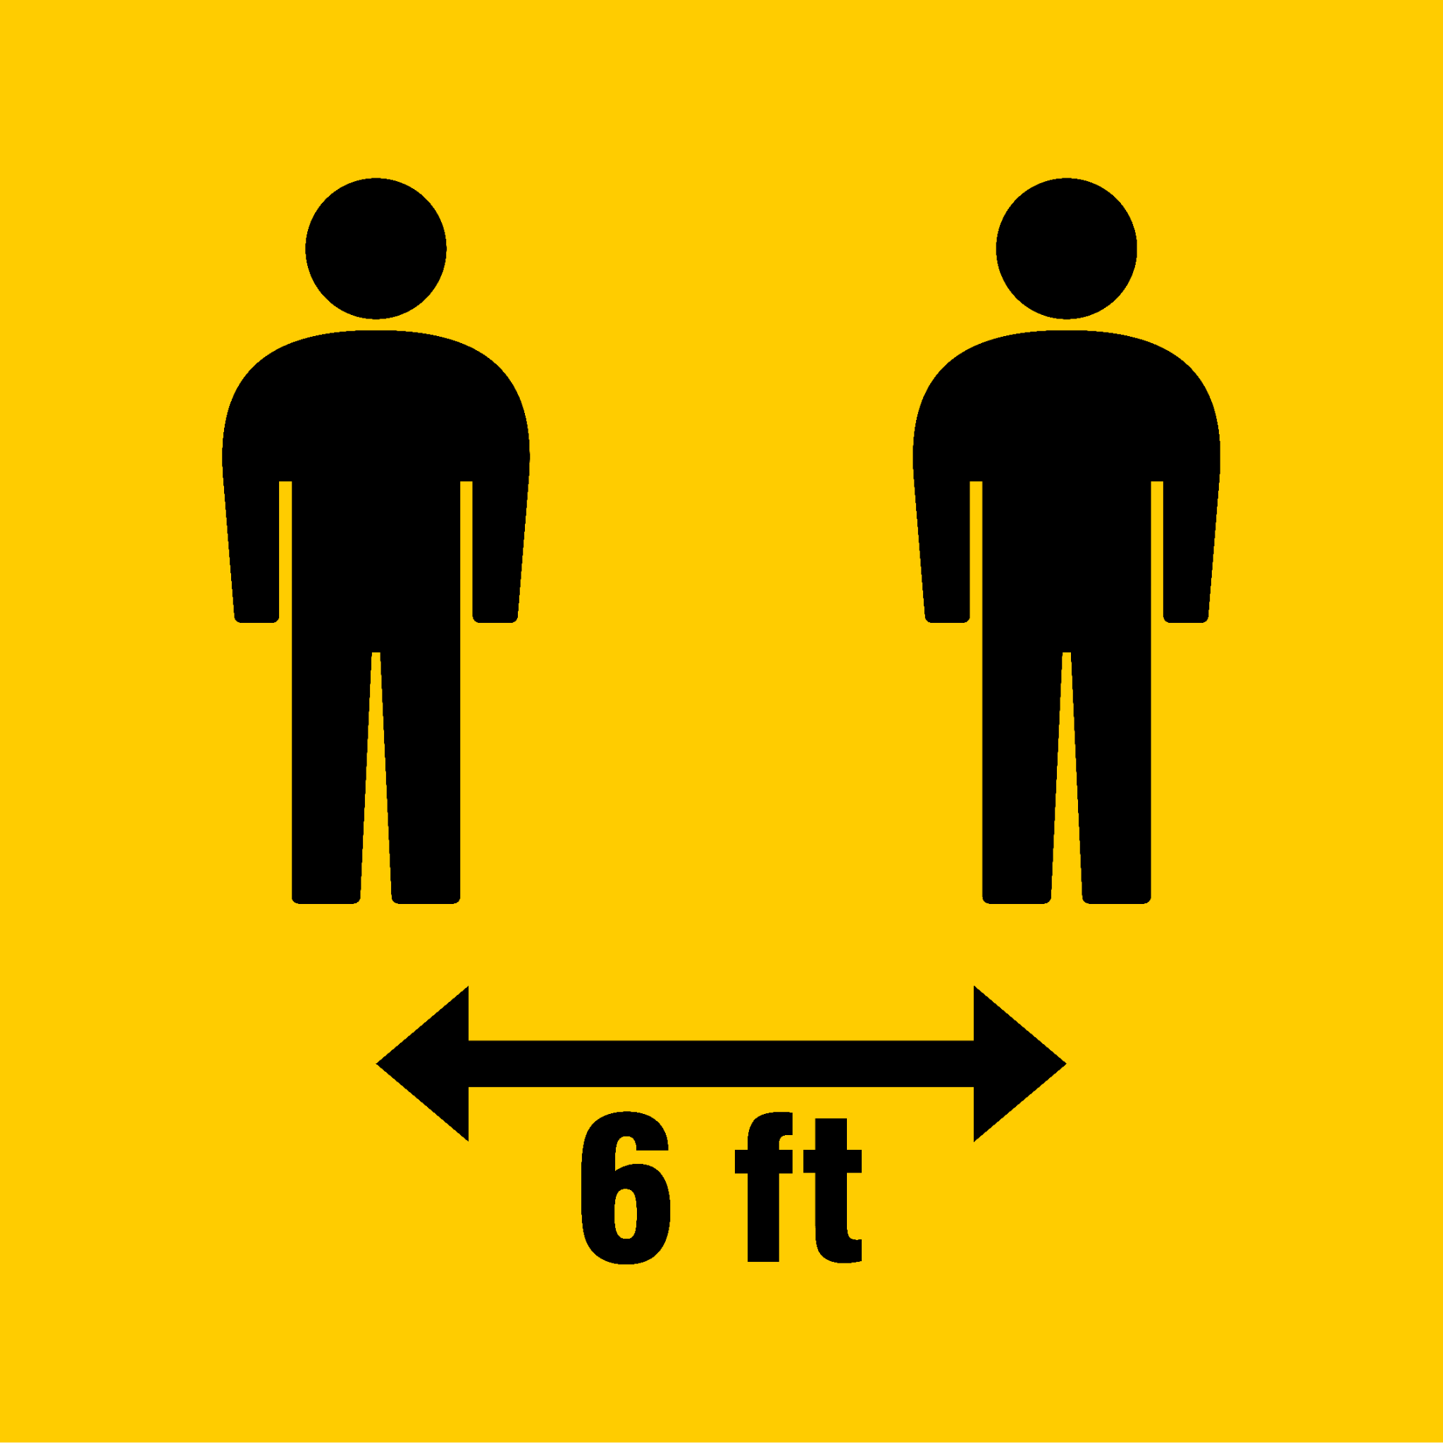
Regression
A variable of distance is continuous.
We can always find a smaller distance by dividing the current distance by half.
Notes:
shutterstock_1675454764

Slide 12
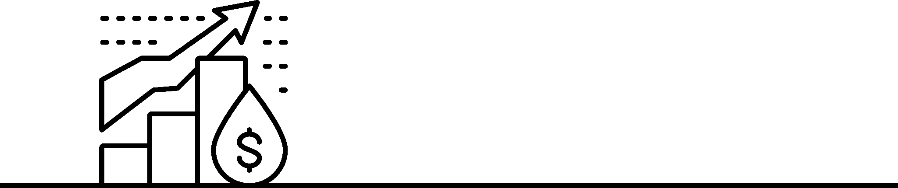
Regression
In finance, prices and rates are usually continuous.
0
10
20
30
40
50
60
Notes:
shutterstock_2131978507

Slide 13
What is classification?

Slide 14
Classification is a method to predict discrete valued variables.
A discrete variable has no middle, and its values cannot be divided.

Slide 15

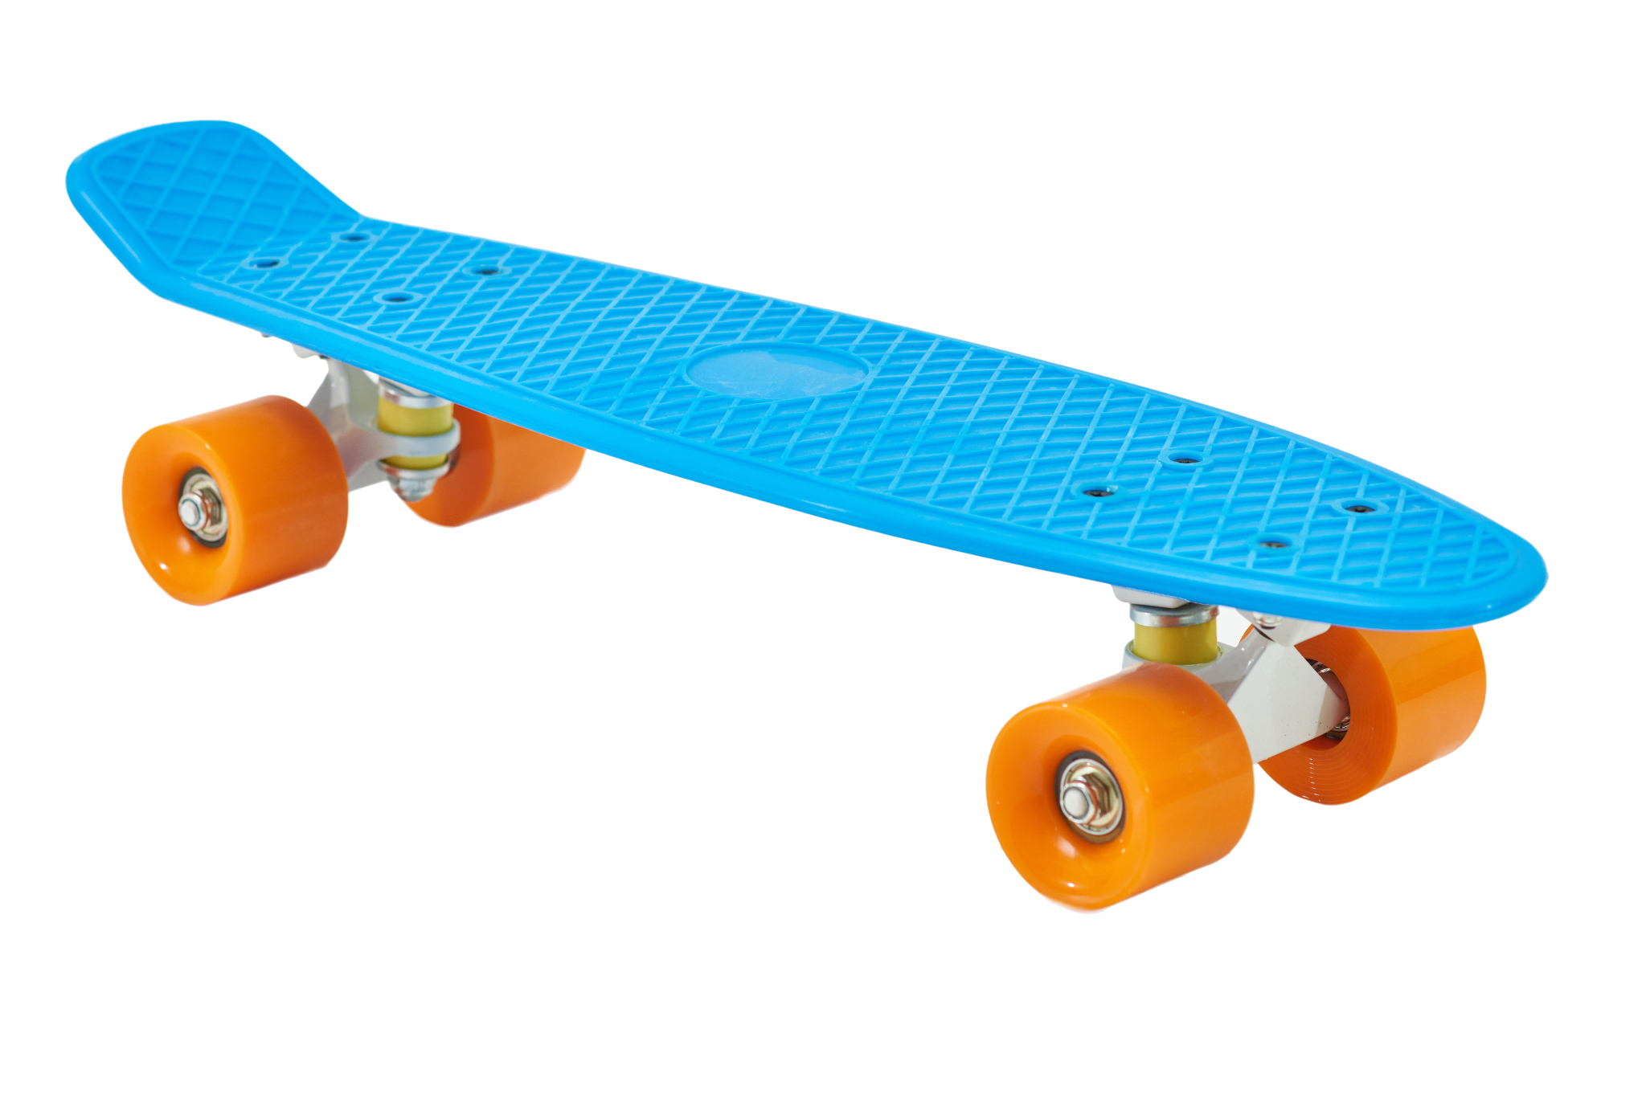
Classification
Consider a loan application that asks:
Do you own a car?
Yes
The possible answers are yes or no.
You either own a car or you don’t.
There is no middle value, so this type of variable, such as car_ownership, would be discrete.
No
Notes:
Shutterstock_278148338_skateboard; shutterstock_794152324_car

Slide 16
Classification
Data analysts use classification to draw categorical conclusions about data.
Instead of forecasting quantitative numbers, classification uses a binary (true-positive / true-negative) approach to predict membership in a category (i.e., will the outcome be of type A or type B).
Qualified loan applicant
Creditworthy
0
Unqualified loan applicant
Credit risk
1
vs.

Slide 17
Classification
Today you’ll learn to perform classification using logistic regression.
In the next class, you’ll discover other tools for classification including support vector machines, decision trees, and random forests.
1
0.75
0.5
0.25
0

Slide 18

Classification
Classification models have greatly improved the ability for organizations to properly classify applicants, predict market decline, and classify fraudulent transactions or suspicious activity.
Most large financial institutions use some form of machine learning to monitor and predict fraudulent activities.
This is how banks know when to flag and decline transactions due to suspicion of fraud.
Notes:
shutterstock_1378147517

Slide 19
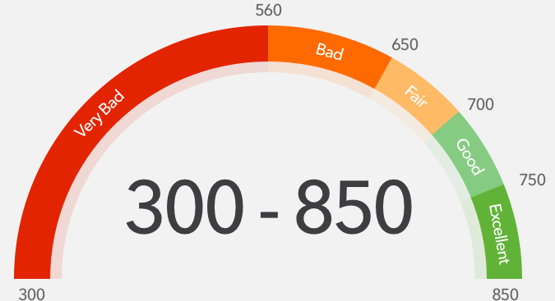
Classification
FICO credit scoring currently uses a classification model for their cognitive fraud analytics platform.
Classification models have allowed the financial industry to become more proactive.
Supervised learning algorithms can predict outcomes with a high degree of accuracy, which allows for more effective and efficient mitigation.
Notes:
shutterstock_603875813

Slide 20
Homework Overview
Notes:
### 2. Instructor Do: Demo Homework (10 minutes)

Slide 21
This week’s homework focuses on creating a classification model for predicting and categorizing credit risk.

Slide 22

Homework Overview
You will use multiple models to complete the homework, including linear regression and decision trees.
These models are available in the `scikit-learn` package.
The homework comprises two goals:
01
Create a classification model that will categorize credit risk.
02
Compare and contrast the various machine learning models for their ability to classify credit risk.

Slide 24
Linear Regression
Notes:
### 3. Instructor Do: Linear Regression (15 minutes)

Slide 25
Linear regression is a model for describing the relationship between a numerical response and one or more variables that explains the response.

Slide 26

Linear Regression
In statistics and machine learning:
Dependent variable
Independent variable
The numerical response is known as the dependent variable because its value depends on other variables.
These other variables that explain the dependent variable are known as independent variables.
We can use the term target variable for the dependent variable.
We can use the term features for independent variables.

Slide 27
Linear Regression
We will explore a simple linear regression with one independent variable.
This type of linear regression is represented by the following formula:
y = a + bX
Slope
Dependent variable
y intercept
Independent variable

Slide 28
y = a + bX
This linear relationship implies the following:
As X increases, y increases.
How fast y increases in relation to X is called the slope.
The slope is represented by the letter b in the formula.
The value of y when X is 0 is called the y-intercept. It is represented by the letter a.
We consider a linear regression to be a supervised learning model because it can predict the value of y based on historical data.

Slide 29
Linear Regression
Let’s implement a simple linear regression model by using scikit-learn.

Slide 30
Linear Regression
Notes:
### 3. Instructor Do: Linear Regression (15 minutes)

Slide 31
Linear Regression Model
The linear regression model is mathematically constructed to minimize the sum of all the errors after they have been squared.
line: y = a + bX
y (dependent)
⋀
y₂
⋀
n
2
(
⋀
y₁
y₂
-
y₂
𝚺
y_{i}
-
y_{i}
)
Minimize:
y₂
Least squares method
i = 1
y-intercept
x₁
x (independent)

Slide 32
One way to assess the accuracy of a linear regression model is to observe the errors.

Slide 33
Linear Regression Model
The linear regression model is mathematically constructed to minimize the sum of all the errors after they have been squared, as the following image shows.
mean squared error (MSE) | The average of the square of the errors of the dataset. It is the variance of the errors in the dataset.
root mean square error (RMSE) | The square root of the MSE. It is therefore the standard deviation of the errors in the dataset.
correlation coefficient | A numerical description of the extent to which the two variables move together. It ranges from -1 to 1.
R2 or r-square value | The square of the correlation coefficient. It describes the extent to which a change in one variable is associated with the change in the other variable. It ranges from 0 to 1.
Low MSE and RMSE scores indicate a more accurate model.

Slide 34
Summary
Key points of linear regression:
It models data with a linear trend. It is not useful when the data does not follow a linear trend, e.g., exponential trends.
Based on the X values, it predicts y values.
It does not do a good job of describing nonlinear patterns.
We will cover techniques to model nonlinear data later in the course.

Slide 36
Activity: Predicting Sales with Linear Regression
In this activity, you will learn apply linear regression to predict sales based on historical data.
15 Minutes
Notes:
### 4. Students Do: Predicting Sales with Linear Regression (15 minutes)

Slide 37
Notes:
### 5. Instructor Do: Review Predicting Sales with Linear Regression (10 minutes)

Slide 39
Notes:
### 6. Break (15 minutes)

Slide 40
Making Predictions with Logistic Regression
Notes:
### 7. Instructor Do: Making Predictions with Logistic Regression (15 min

Slide 41
Logistic regression is a statistical method for predicting binary outcomes from data.

Slide 42
Making Predictions with Logistic Regression
Each data point receives a probability of being in the 1 category (e.g. “good credit”).
1
Curve of Predicted Values
0.5
Probability of Good Credit
Threshold for Good Credit classification
(Payment History > X)
(Probability “Good Credit” > 50%)
0
(Worse History) ← Payment History → (Better History)

Slide 43
Making Predictions with Logistic Regression
If the probability is above a certain threshold, that data point is estimated to be a 1 (“good credit”). Below that threshold, the data point is a (0).
1
Classified as good credit
(probability > 50%)
Probability
0.5
Classified as bad credit
(probability < 50%)
0
Threshold for Classification

Slide 44
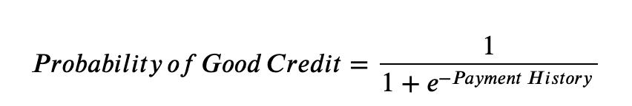
The Sigmoid Function
Logistic Regression converts using a sigmoid (or squashing) function:
Performing behind the scenes, this function converts continuous data on the borrower (e.g., number of months without a delinquent payment) to a percentage probability of being a “good credit” borrower.
A good logistic regression model will use more information than just “payment history,” but the sigmoid function can still convert all this information into a probability.

Slide 45
The Sigmoid Function
How do we translate continuous data like payment history into a probability of “good credit” ranging from 0 to 1?
1
Curve of Predicted Values
0.5
Probability of Good Credit
0
(Worse History) ← Payment History → (Better History)

Slide 46
Steps in Logistic Regression Modeling
We can use logistic regression to predict which category or class a new data point should go into.
01
02
03
04
Preprocess | Train | Validate | Predict
This step consists of cleaning the data (such as removing rows with missing values) and splitting it into subsets for training and testing the model. | Training is when we use a large subset of our labeled data to teach the model to recognize classification patterns. | In the validation step, we use a small subset of our labeled data to test how well the model is able to predict labels. | Finally, we use our model to predict labels for unclassified data.

Slide 47
Making Predictions with Logistic Regression

Slide 48
Hold-Out Validation
Hold-out validation is the concept applied with the function train_test_split.
We create two datasets where we hold out a subset of data that we refer to as the testing dataset.
This allows us to measure the performance of our model and parameter selections with a subset of data not used to train the model.
Training Set |  |  |  |  | Test Set

Slide 50
Activity: Predicting Diabetes with Logistic Regression
In this activity, you will see how logistic regression works on the real-world problem of fraud detection.
20 Minutes
Notes:
### 8. Students Do: Predicting with Logistic Regression (20 minutes)

Slide 51
Notes:
### 9. Instructor Do: Review Predicting with Logistic Regression (10 minutes)

Slide 53
Evaluating Logistic Regression Predictions
Notes:
### 10. Instructor Do: Evaluating Logistic Regression Predictions (5 minutes)

Slide 54

Evaluating Logistic Regression Predictions
In this scenario, we used a logistic regression model to predict if an individual has diabetes, based on a set of diagnostic metrics provided as a dataset.
We evaluated the logistic regression model by using a scoring feature.
This revealed that the model is somewhat accurate.
However, can you trust that its predictions are correct?
Notes:
shutterstock_1182660097

Slide 55
How sure are you that your models can actually predict diabetes?

Slide 56
78%
sure, as described by the scored accuracy.
Notes:
shutterstock_1182660097

Slide 57
Would you feel comfortable giving the diagnosis of diabetes based on the predictions of the model?

Slide 58
Answer
No.
The prediction is not 100% accurate.
There is room for error, and there are false positives.
 | Test says you don’t have it | Test says you do have it
You don’t really have it | True Negative | False Positive
You do really have it | False Negative | True Positive

Slide 59
What is better: the false-positive or false-negative?

Slide 60

Answer
Neither option is preferred. Both leave opportunities for inaccuracy.
However, in the case of a model that incorrectly flags patients as having diabetes, we can use additional tests to refine the prediction and filter out individuals who do not have diabetes.
This way, anyone with the potential of having the disease can be given the treatment and attention they need.
Notes:
shutterstock_1156968376

Slide 61
The process of evaluating a model requires more than simply scoring/measuring the model for accuracy.

Slide 62

In addition to accuracy, we must measure for precision and recall, both of which can be used to eliminate false positives and false negatives.
Notes:
shutterstock_746970784

Slide 64
Accuracy, Precision, Recall
Notes:
### 11. Instructor Do: Accuracy, Precision, Recall (10 minutes)

Slide 65
Accuracy, Precision, and Recall
Accuracy, precision, and recall are especially important for classification models that involve a binary decision problem. Binary decision problems have two possible correct answers: True Positive and True Negative.
True positive True negative
False positive False negative

Slide 66
Accuracy, Precision, and Recall
Inaccurate and imprecise models will return false positives and false negatives.
True positive True negative
False positive False negative

Slide 67
Accuracy is how often the model is correct—the ratio of correctly predicted observations to the total number of observations.

Slide 68
Accuracy
Scoring will reveal how accurate the model is. However, it does not communicate how precise it is.
Data Set
 | Training Set |  | Validation Set
Test Set

Slide 69
Accuracy
Accuracy can be very susceptible to imbalanced classes. In the case of identifying poor loan candidates, the number of good loans greatly outweighs the number of at-risk loans. In this case, it can be really easy for the model to only care about the good loans, because these have the biggest impact on accuracy. However, we also care about the at-risk loans, so we need a metric that can help us evaluate each class prediction.
Calculation:
(TP + TN) / (TP + TN + FP + FN)

Slide 70
Precision is the ratio of correctly predicted positive observations to the total predicted positive observations.
(i.e., of all the samples classified as having diabetes, how many actually have diabetes?)

Slide 71
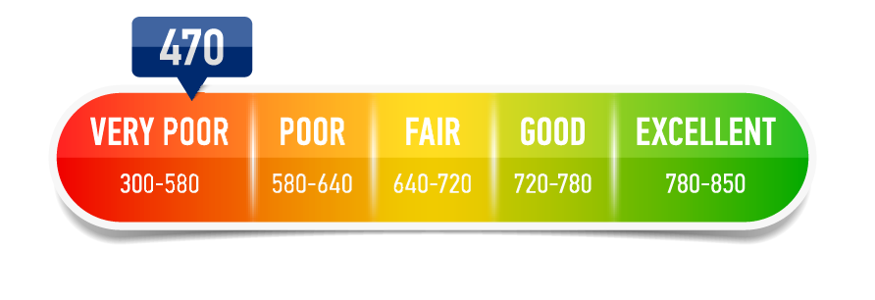
Precision
Another example: For all the individuals who were classified by the model as being a credit risk, how many actually were a credit risk?
Did we classify them comprehensively and correctly?
Notes:
shutterstock_512605756

Slide 72
Precision
High precision relates to a low false positive rate.
Calculation:
TP / (TP + FP)

Slide 73
Recall is the ratio of correctly predicted positive observations to all predicted observations for that class.
(i.e., of all of the actual diabetes samples, how many were correctly classified as having diabetes?)

Slide 74
Recall
Of all of the actual diabetes samples, how many were correctly classified as having diabetes?
Did we classify all samples correctly, leaving little room for false negatives?
True positive True negative
False positive False negative

Slide 75
Recall
Another example:
For all the individuals who are a credit risk, how many were classified by the model as being a credit risk?

Slide 76
Recall
High recall correlates to a more comprehensive output and a low false negative rate.
Calculation:
TP / (TP + FN)

Slide 78
Confusion Matrix & Classification Report
Notes:
### 12. Instructor Do: Confusion Matrix & Classification Report (10 minutes)

Slide 79
We use a confusion matrix to measure and gauge the success of a model.

Slide 80
Confusion Matrix
Confusion matrices reveal the number of true negatives and true positives (actuals) for each categorical class and compare them to the number of predicted values for each class.
n=165 | Predicted: No | Predicted: Yes
Actual=No | 50 | 10 | =60
Actual=Yes | 5 | 100 | =105
 | =55 | =110

Slide 81
Confusion Matrix
These values are then individually summed by column and row. The aggregate sums are then compared to assess accuracy and precision. If the aggregates match, we can consider the model to be accurate and precise.
n=165 | Predicted: No | Predicted: Yes
Actual=No | 50 | 10 | =60
Actual=Yes | 5 | 100 | =105
 | =55 | =110

Slide 82
Confusion Matrix
Confusion matrixes are great because they describe the performance of the classification model.
By looking at the confusion matrix, we can determine whether the model has been correctly trained to produce comprehensive, accurate, and precise predictions.
For binary classifiers like the logistic regression classifier, a confusion matrix will measure the number of positive and negative predictions.
These will then be compared to the actuals.

Slide 83
How do we get data loaded into a confusion matrix for model evaluation?

Slide 84
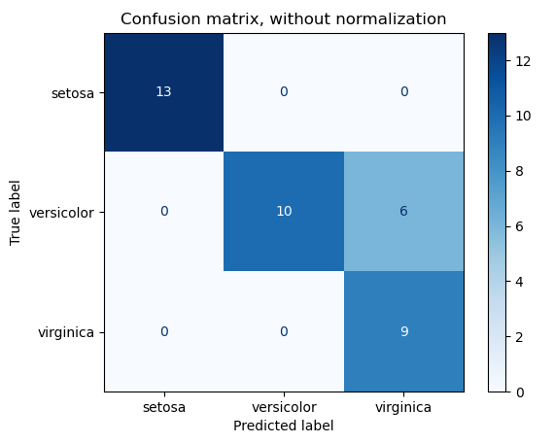
Confusion Matrix
Most models will come equipped with a confusion matrix module, such as the sklearn metrics.confusion_matrix module.
The function accepts two arguments, one dataset containing the predicted values and another containing the actual data points.

Slide 85
You can also use a classification report to evaluate a model.

Slide 86
A classification report holds the test results so we can assess and evaluate the number of predicted occurrences for each class.

Slide 87
Classification Report
Classification report identifies the precision, recall, and accuracy of a model for each given class.
 | precision | recall | fl-score | support
No Diabetes | 0.77 | 0.90 | 0.83 | 125
Diabetes | 0.72 | 0.49 | 0.58 | 67
accuracy |  |  | 0.76 | 192
macro avg | 0.74 | 0.69 | 0.71 | 192
weighted avg | 0.75 | 0.76 | 0.74 | 192

Slide 88
Confusion Matrix

Slide 89
Activity: Evaluating Classification Models
In this activity, you will practice building and interpreting classification reports and confusion matrixes on consumer usage data for a financial app.
20 Minutes
Notes:
### 13. Students Do: Evaluating Classification Models (20 minutes)

Slide 90
Notes:
### 14. Instructor Do: Review Evaluating Classification Models (10 minutes)

